Slide 1
Online Spice Shopping
Submitted by,
Jickson Jose
22PMC132

Slide 2
Abstract
Spice Shopping is an innovative e-commerce platform designed to transform the way people discover, explore, and purchase spices online. The key objective of Spice Shopping is to offer a user-friendly interface that simplifies the spice purchasing process. Through an intuitive and visually appealing website, customers can effortlessly browse through a wide range of spices, each accompanied by detailed descriptions, origins, flavor profiles, and suggested culinary uses. Spice Shopping search and filtering capabilities enable users to find specific spices based on various criteria and buy it.
Online Spice Shopping

Slide 3
Requirements
Product Catalogue Management: This involves managing the products available in the online store
1.
Product Search and Filtering: It's important to provide users with the ability to search for products based on keywords or specific criteria
2.
3.
Product Reviews and Ratings: Customers often rely on product reviews and ratings to make informed purchasing decisions.
4.
Shopping Cart and Checkout: A shopping cart system allows users to add products they wish to purchase and proceed to the checkout process
Order Management: This feature involves managing customer orders. It includes functionalities such as tracking the status of orders, generating invoices, handling returns and refunds, and managing order history
5.
Online Spice Shopping

Slide 4
Customer Account Management: Users should be able to create and manage their accounts within the online store.
6.
7.
Wishlist : Users often have the need to save products they are interested in for future reference.
8.
Payment Processing: To facilitate online transactions, integrating secure and reliable payment gateways is crucial.
9.
Customer Support: Providing customer support channels such as a contact form.
10.
Mobile Responsiveness and Accessibility: With the increasing use of mobile devices, ensuring that the online store is mobile-responsive and accessible is essential.
Online Spice Shopping

Slide 5
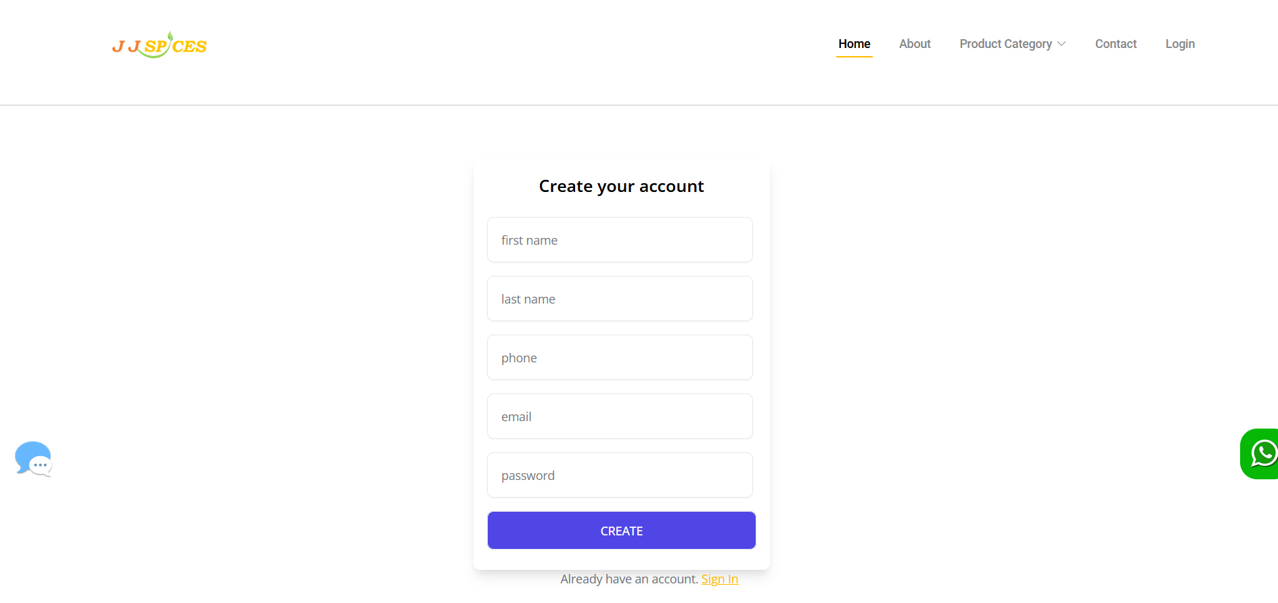

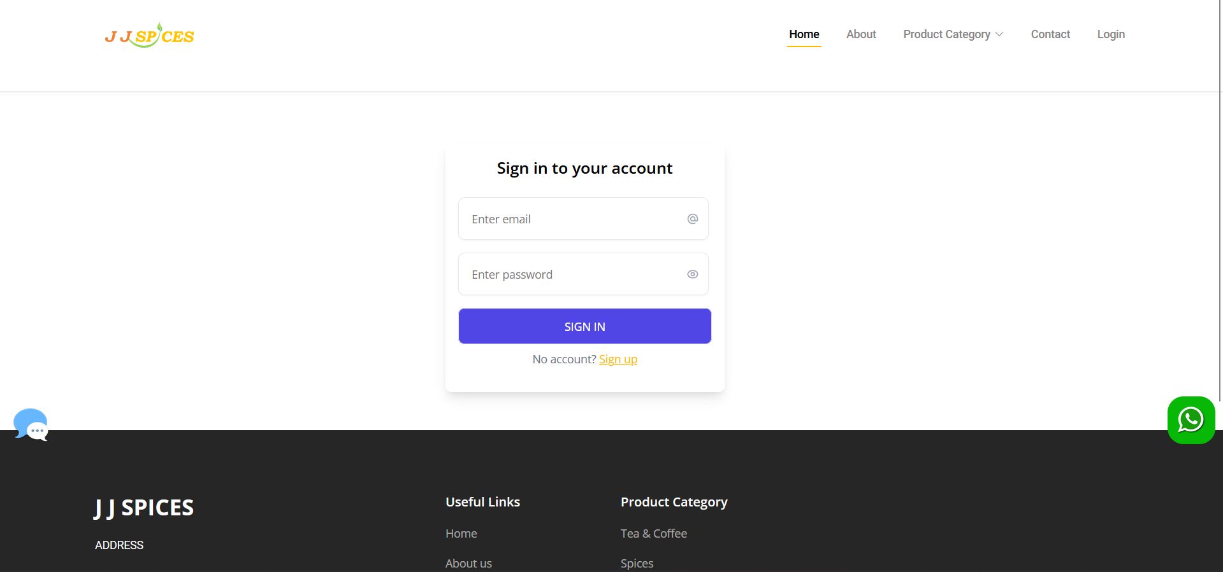
Features And Highlights
Registration
The system used by a new user. His/her give the details such as name, username, password, email, phone number. The user should give a unique username. If the user taken a username that already existed cannot signup the website. The password must be 8 character contain alphanumeric.
Login
The user can login to the page by using there own unique username and the password. The password must be contain numbers special character and the alphabet, the length become 8.
Online Spice Shopping

Slide 6
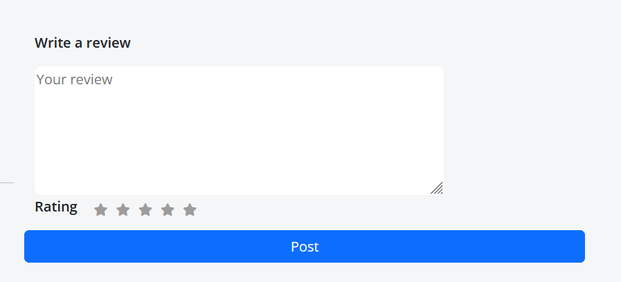
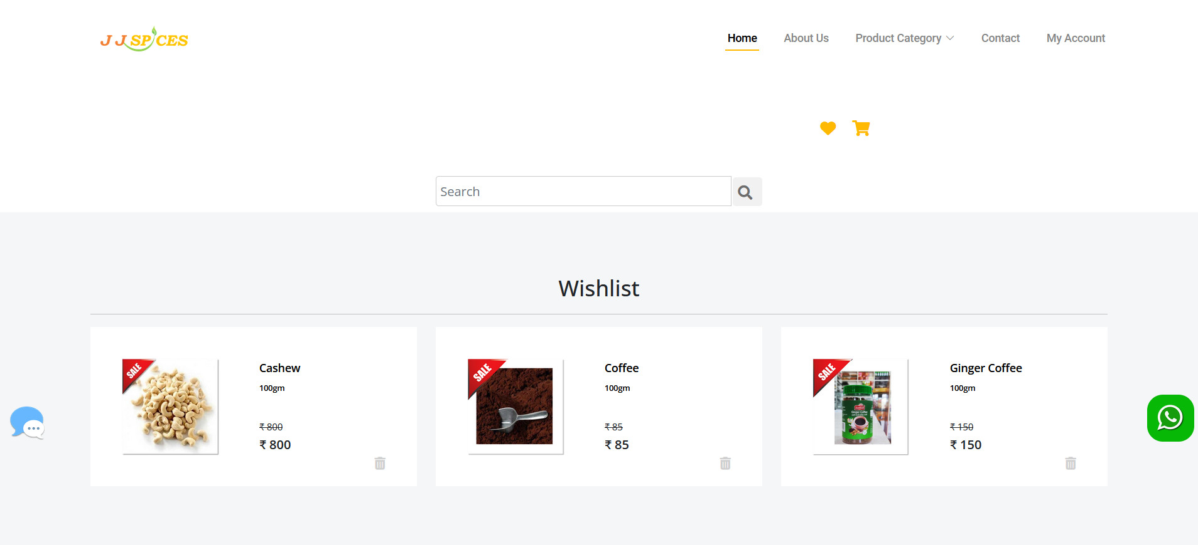
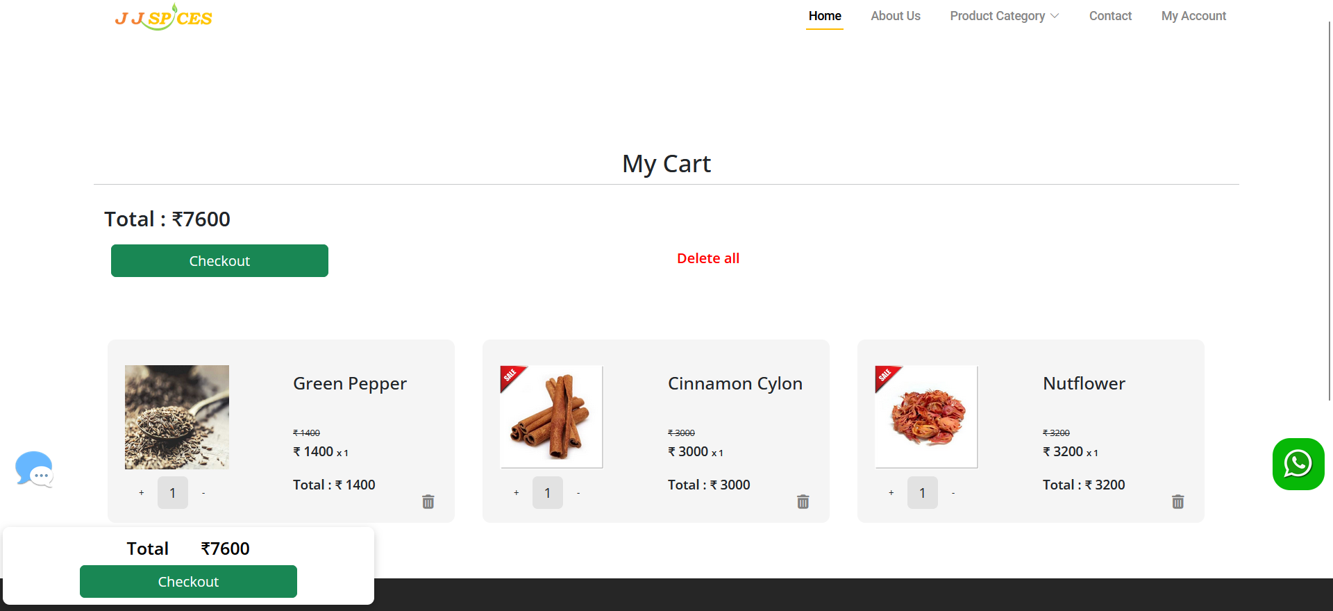
Features And Highlights Cont…..
Rating
The user can rate there product here. There rating containing 5 stars.
Wishlist
Users can add products they wishlist to purchase later
Cart
Users can add products they wish to purchase and proceed to the checkout process
Online Spice Shopping

Slide 7
Third Party Libraries
BOOTSTRAP
STRIPE
JAZZMIN
Online Spice Shopping

Slide 8
Architecture
User Interface: The user interface is the front-end component of the system that customers interact with, which users can browse spices, view product details, add items to their cart, and proceed to checkout.
Product Catalog Management: It includes functionalities for adding new products, updating product information (such as name, description, price, and images), categorizing spices, and managing stock levels.
Shopping Cart: The shopping cart functionality allows users to add spices to their cart as they browse the website. It enables customers to review their selected items, adjust quantities, and remove items before proceeding to checkout.
User Registration and Authentication: Customers can create user accounts on the online spice shop, providing their personal information such as name, contact details, and shipping address. The authentication component handles user login, session management, and ensures secure access to customer-specific information.
Payment Gateway Integration: This component enables customers to securely make online payments for their spice purchases.
Online Spice Shopping

Slide 9
Reviews and Ratings: Customers can provide feedback and ratings for spices they have purchased. This component manages customer reviews, allows customers to submit ratings, and displays reviews on the website to help future customers make informed decisions.
Order Management: The order management component handles the processing of customer orders. It includes functionalities for generating order numbers, recording order details (selected spices, quantities, pricing), managing order status (pending, confirmed, shipped), and tracking shipments.
Online Spice Shopping

Slide 10
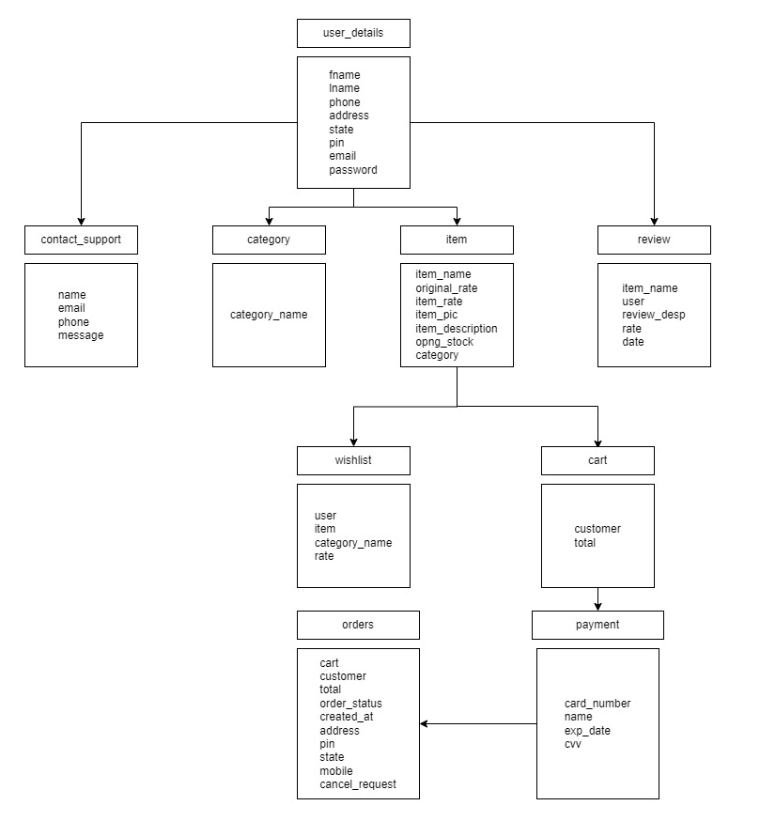
Class Diagram
Online Spice Shopping

Slide 11
Challenges Faced During Development
Handling Checkout and Secure Payment.
Handling data validation and ensuring data integrity during various operations.
Integrating the inventory system with Django libraries
Creating a user-friendly interface that is intuitive and easy to navigate
Implementing secure user authentication and authorization mechanisms
Balancing the need for a visually appealing design with functional requirements.
Online Spice Shopping

Slide 12
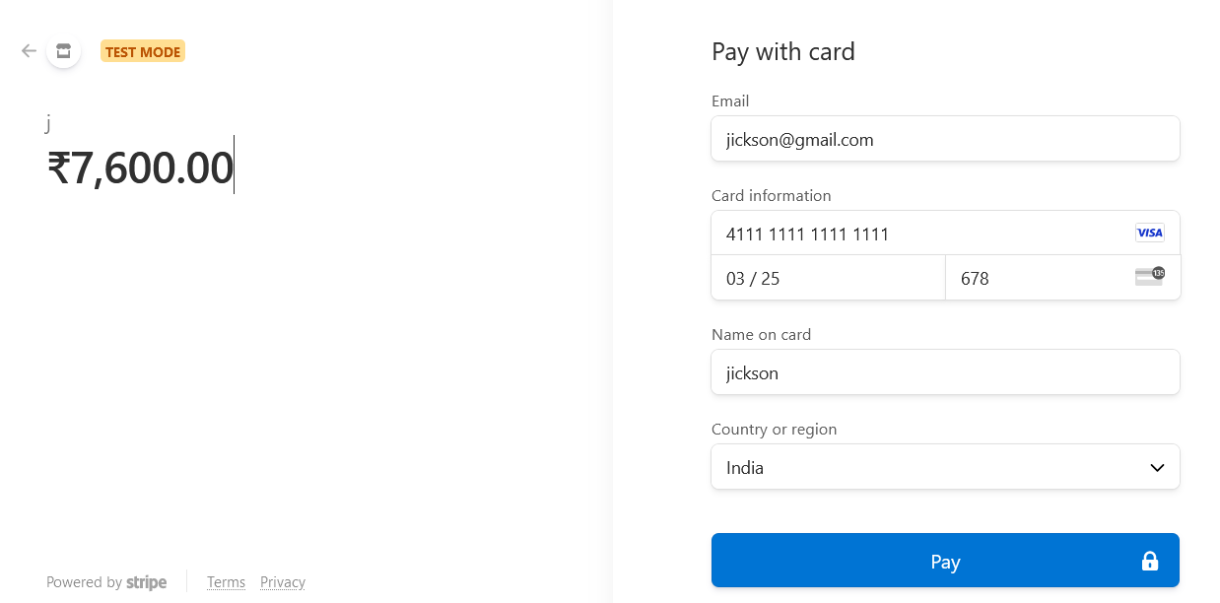
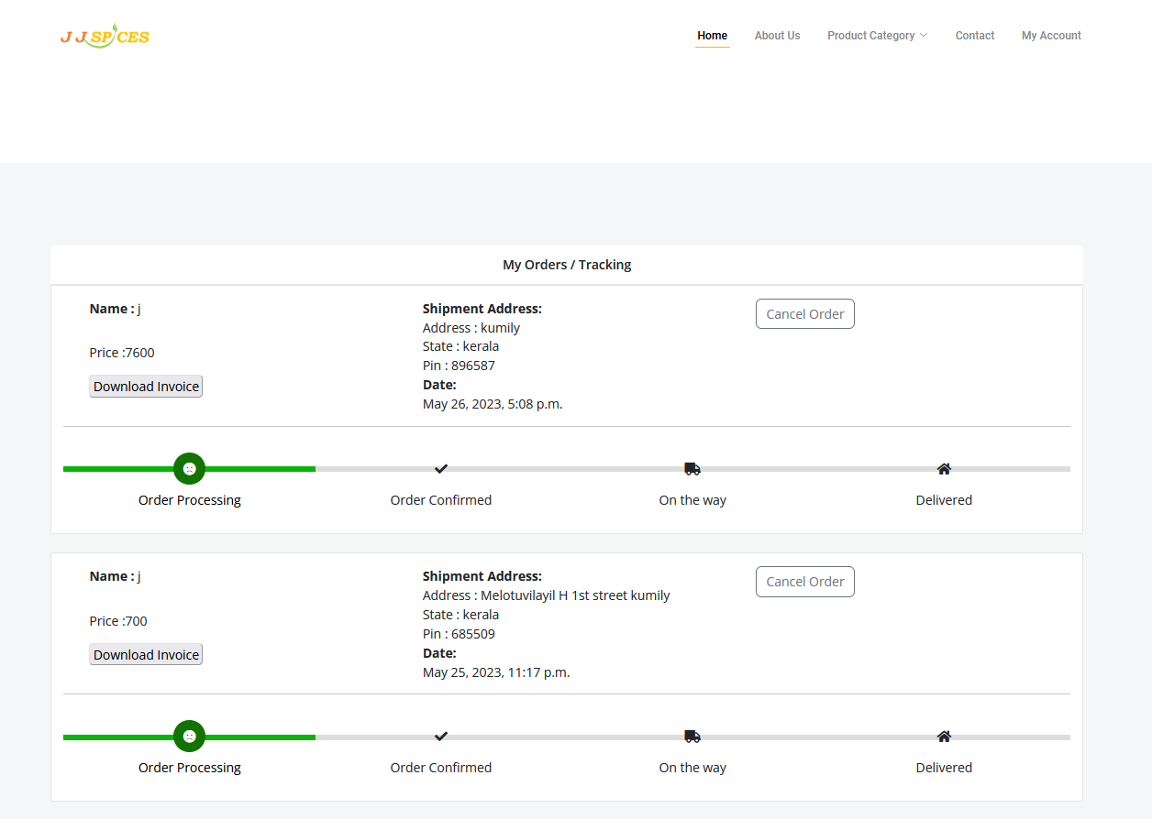
Important Screenshots With Explanation
Payment
Users can make payment for their purchase
Customer Orders
Users can see their orders of their purchase and also they can track their order.
Online Spice Shopping

Slide 13
Future Enhancements
Artificial Intelligence (AI) C: Implement AI-powered to provide automated support to Customers. AI can handle common inquiries, assist with Purchase history and make recommendations for customers.
Advanced Search and Filters: Improve the search functionality by implementing advanced filters based on category , amount, ratings, and other criteria. This enables customers to refine their search and find their appropriate products.
Mobile Application: Develop a mobile application for the spice shopping, allowing customers to access the website on their smartphones. The app can provide a user-friendly interface, push notifications for new products and offers.
Online Spice Shopping

Slide 14
Conclusion
In conclusion, the spice shopping e-commerce website offers a convenient and efficient platform for customers to purchase a wide variety of spices online. The website provides a user-friendly interface, allowing customers to browse through an extensive selection of spices, explore different brands and types, and make informed decisions based on detailed product descriptions and customer reviews. The e-commerce platform ensures a seamless shopping experience by incorporating secure payment gateways and reliable shipping options, ensuring that customers receive their orders in a timely manner.
Online Spice Shopping

Slide 15
References
https://www.keralaspicesonline.com/
https://www.amazon.in
Online Spice Shopping

